Slide 1
Pharmacognosy Lab: 5
Precipitation

Slide 2
Precipitation: It is one of the separation methods; formation of a separable solid substance from a solution, either by converting the substance into
an insoluble form or by changing the composition
of the solvent to diminish the solubility of the substance in it. The precipitate typically agglomerates, and then is separated from the liquid by sedimentation, centrifugation, or filtration.

Slide 3
One of the best examples of precipitation reactions is the chemical reaction between potassium chloride and silver nitrate, in which solid silver chloride is precipitated out. This is the insoluble salt formed as a product of the precipitation reaction. The chemical equation for this precipitation reaction is provided below.
AgNO3(aqueous) + KCl(aqueous) —–AgCl(precipitate) + KNO3(aqueous)

Slide 4
Our experiment about separation of tannin because the ability of these substance to precipitate proteins and minerals such as (lead) by forming complex with them.
Source of tannins:
Nutgall Quercus infectoria
Tea Camellia sinensis
Medicinal properties and uses:
Tannins are medicinally significant due to their astringent properties. They promote rapid healing and the formation of new tissues on wounds and inflammed mucosa.

Slide 5
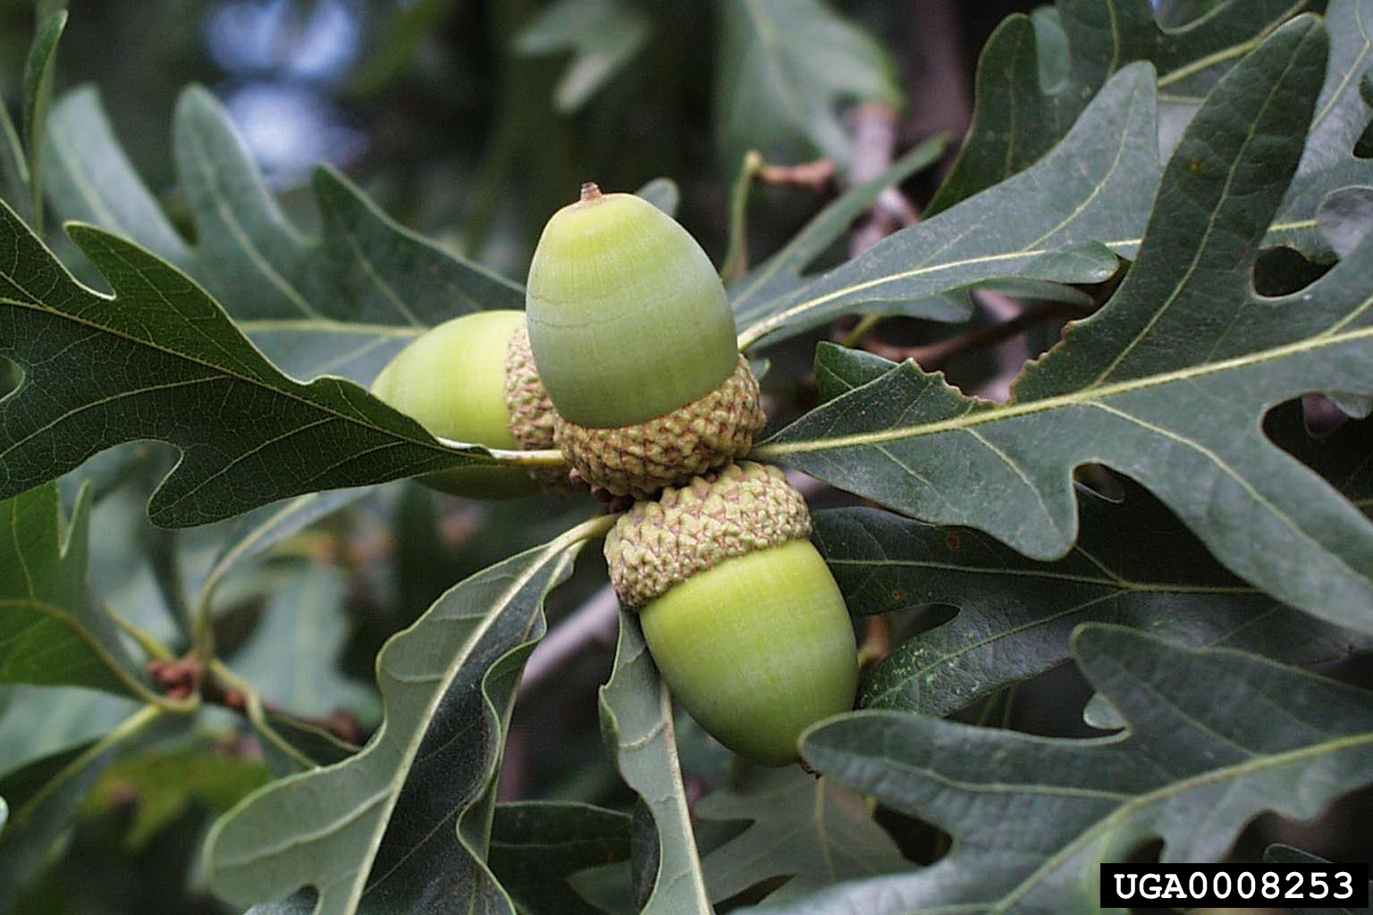
Nut gall
Quercus infectoria
Active part :
Gall (which is pathological outgrowth obtained from the young twigs of the dyers oak)

Slide 6
Tea Camellia sinensis
Active part : Leaves of plant

Slide 7
Procedure:
Prepare plant extract: 1gm of plant in 200 D.W (decoction method)
Tests : Gelatin test: 1 ml of Extracts mixed with few drops of 1% gelatin solution; the mixture gives white precipitate. Note: gelatin is protein.
Lead acetate tests: 1 ml of Extracts mixed with 10 % lead acetate; the mixture gives white precipitate .

